Slide 1
Lesson Overview
Any jurisdiction’s or agency's emergency management activities should be based on a thorough planning process, which is documented in its Emergency Operations Plan (EOP).
Jurisdiction and agency planning processes should include identifying resource needs based on the threats to and vulnerabilities of the jurisdiction and developing alternative strategies to obtain the needed resources.
This lesson will focus on the relationship between planning and resource management.

Slide 2
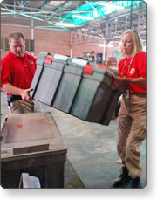
Unit 2 Objectives
At the end of this Unit, you should be able to:
Describe the relationship of the jurisdiction’s advance planning to resource requirements.
Identify sources for emergency resources, including public, private, and nongovernmental organizations.
Describe the mechanisms for ensuring that resources are available during incidents.
Describe the relationships among various entities regarding resource management, and the enabling mechanisms that provide for seamless integration.

Slide 3
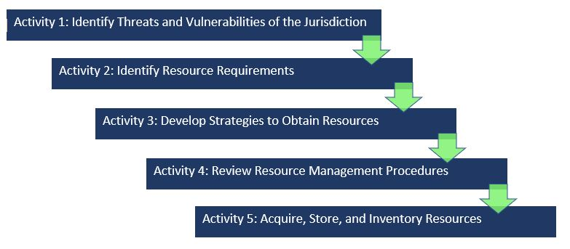
Resource Management Planning Activities
This lesson is organized around the following planning activities:

Slide 4
Risk-Based Planning
The planning process includes identifying resource requirements based on the threats to, and vulnerabilities of, the jurisdiction or organization. Planning also includes developing alternative strategies to obtain needed resources. Resource management personnel should consider resources necessary to support all mission areas (Prevention, Protection, Mitigation, Response, and Recovery).
There are a number of methodologies that can be used for identifying your risks, but all methodologies should:
Identify possible kinds of incidents and their related threats, risks, or consequences. (What might happen?)
Quantify the likelihood of an occurrence of any given incident. (How likely is it to happen?)
Assess the most likely magnitude of any given incident. (How bad is it likely to be?)
Assess the percent of the population at risk from any given incident. (How many people might be injured or killed?)
Assess the severity of impact or likely consequences of any given incident. (How much damage is there likely to be?)
This analysis will result in a picture of the most likely incidents, their potential consequences. Understanding what you are preparing to respond to will help you to identify the resources that are required.

Slide 5
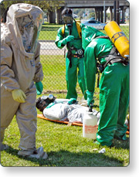
Step 1: Identify Threats and Vulnerabilities of the Jurisdiction
The first activity in establishing resource needs is to consider the anticipated threats and vulnerabilities and their potential consequences for your jurisdiction.
In identifying threats and vulnerabilities, it is important to consider the cascading events or related emergencies that may follow an incident. For example, an earthquake may cause:
Building and bridge collapses
Hazardous materials spills
Utility outages
Your jurisdiction’s Emergency Operations Plan should include hazard analysis information.

Slide 6
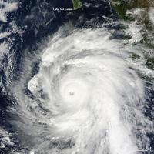
Activity 2: Identify Resource Requirements
After analyzing the threats and vulnerabilities, next determine what resources are needed to manage the identified incidents. Resources address the potential consequences of anticipated threats and vulnerabilities. Some resources will be specific to only one threat or vulnerability; others may be useful for multiple threats or vulnerabilities.
Example: Urban rescue resources would likely only be needed for building collapses following a hurricane, but resources associated with traffic control would be needed to assist with debris removal, security, and damage to bridges and roads.

Slide 7
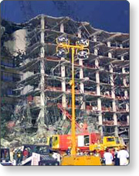
Researching Incidents
Identifying resource requirements for a threat or vulnerability that you have not experienced can be difficult.
For example, prior to the bombing of the Alfred P. Murrah Building in Oklahoma City emergency managers had not considered the need for resources that could dispose of large quantities of bio-hazard waste.
Another example of a frequently overlooked or underestimated resource requirement is the needs associated with populations that are not fluent in the English language. In an incident there will be distinct resource requirements related to these populations.
Researching infrequent or unfamiliar incidents can be useful. Consider reviewing case histories and incident after action reviews or interviewing managers of similar incidents to gain information.

Slide 8
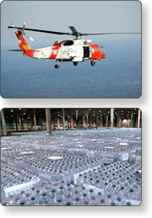
Common Resources
Resources you identify fall into five general groupings:
Personnel: Includes Incident Command System "overhead" or management staff, technical specialists, Emergency Operations Center staff, operations staff, etc.
Teams: Refers to groups of specially trained and equipped personnel, including needed equipment and supplies.
Facilities: Includes office space, shelters, warehouses, etc.
Equipment: Refers to pieces of equipment, with or without the personnel needed to operate them.
Supplies: Can span an enormous range from potable water to plywood. It is impossible to develop and maintain complete lists. A more efficient way to plan is to develop and maintain a current list of suppliers with comprehensive inventories.

Slide 9
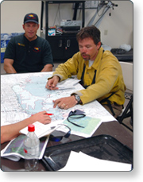
Resource Typing
Thinking ahead about the appropriate configuration and capabilities of emergency resources can ensure that incidents receive the right resource for the job.
Resource typing is defining and categorizing incident resources by capability.
Resource typing definitions establish a common language for discussing resources by defining minimum capabilities for personnel, teams, facilities, equipment, and supplies.
Resource typing enables communities to plan for, request, and have confidence that the resources they receive have the capabilities they requested.
The next lesson presents additional information on resource typing.

Slide 10
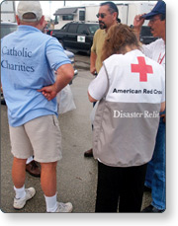
Activity 3: Develop Strategies to Obtain Resources
Resources come from a variety of sources, including:
Within your agency or jurisdiction
Mutual aid and assistance
Other levels of government
Volunteer organizations
Private-sector sources
Donations
We will discuss these sources in detail on the following screens.

Slide 11
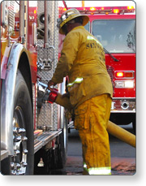
Agency or Jurisdiction Resources
The first source to consider is the current capability and inventory of your own agency or jurisdiction. During an incident, you will normally exhaust your own resources before you approach the next level of government for assistance. Consider:
What resources are already owned by your agency, and are they suitable for use in emergencies?
What supplies does your agency usually warehouse?
What training and experience do your agency personnel have?
Analysis of personnel should include not only their job-related training, skills, and experience, but can include relevant additional experience, hobbies, or part-time job skills.

Slide 12
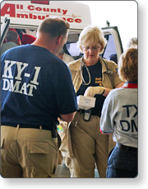
Mutual Aid
Mutual aid involves sharing resources and services between jurisdictions or organizations. Mutual aid occurs routinely to meet the resource needs identified by the requesting organization.
This assistance can include the daily dispatch of law enforcement, emergency medical services (EMS), and fire service resources between local communities, as well as the movement of resources within a state or across state lines when larger-scale incidents occur. Mutual aid can provide essential assistance to fill mission needs.
Mutual aid agreements and compacts establish the legal basis for two or more entities to share resources. They exist among and between all levels of government. These agreements support effective and efficient resource management.

Slide 13
Emergency Management Assistance Compact
EMAC is a congressionally ratified mutual aid compact that defines a non-Federal, state-to-state system for sharing resources across state lines during an emergency or disaster.
Signatories include all 50 states, the District of Columbia, Puerto Rico, Guam, and the U.S. Virgin Islands.
EMAC’s unique relationships with states, regions, territories, and Federal organizations, such as FEMA and the National Guard Bureau, enable it to move a wide variety of resources to meet the jurisdictions’ needs.
To learn more about EMAC, visit this website: www.emacweb.org.

Slide 14
Lessons Learned: Mutual Aid Agreements and Compacts
Both local and State emergency managers have experience with mutual aid agreements and compacts. Here, State and local emergency managers talk about best practices using mutual aid and assistance agreements.
Lessons Learned Example:
Local Emergency Manager
We have negotiated mutual aid agreements with adjacent law enforcement, fire, public works, and EMS agencies. This expands our resource pool and also provides agreed-upon procedures for dispatch, resource management, and reimbursement. We are a pretty large jurisdiction for this State, but even so, we would not be able to manage a major disaster without help.
State Emergency Manager
Once our own State and local resources have been expended, our next best source of resources is through our EMAC agreements with the States adjacent to us. These resources are familiar, and able to respond in a relatively short time. The States also have clear procedures for dispatching them, managing them at the incident, and reimbursement. This ensures that no time is lost if we need assistance or to send resources to a neighboring jurisdiction.

Slide 15
Discussion Question
What agreements has your agency or jurisdiction entered into?

Slide 16
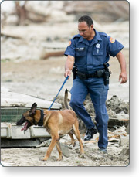
Other Levels of Government
Public-sector emergency managers should have a good idea of resources available at all levels of government, their capabilities and support needs, and response times.
Consider that resource availability is not guaranteed. Planners should verify that multiple jurisdictions are not relying on the same resources. Some resources may be utilized elsewhere. For example, members of the National Guard may not be available as incident resources if they have been deployed overseas or are already being utilized elsewhere.
You should assume that resources outside the incident area (State and Federal resources) will take up to 72 hours to arrive. It should also be reinforced that all resource requests to other levels of government must follow the established request procedures.

Slide 17
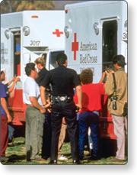
Volunteer Organizations
Many volunteer nongovernmental organizations (NGOs) play major roles in emergency response. Commonly referred to as Volunteer Organizations Active in Disasters, or VOAD, the number and degree of formal organizations vary from State to State.
Knowing what volunteer agencies are active in your area, what resources they can provide, and how to effectively activate and incorporate these resources is critical to your resource analysis process. It is helpful to include these organizations in your planning process.
Some jurisdictions have VOAD Councils designed to coordinate with each other and with public-sector entities. Such councils can be an extremely useful tool in both the planning and the activation processes, especially if resource requests can be forwarded to the council for resolution.

Slide 18
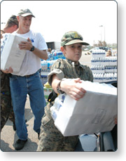
Involving Voluntary Agencies
Failure to include voluntary organizations in your planning and exercises can result in duplication of effort or resource shortfalls.
A management challenge is that some may show up as "spontaneous volunteer organizations" and may not understand the need to check in with either the Incident Commander or the Emergency Operations Center. This can result in:
Failure to integrate VOAD resources into formal response, leading to loss of accountability.
Potential safety issues.
Public relations problems.
Lack of confidence in the jurisdiction's entire emergency management ability to respond to an incident.

Slide 19
Private-Sector Partners
Private-sector organizations play a key role before, during, and after an incident. First, they must provide for the welfare and protection of their employees in the workplace. In addition, emergency managers must work seamlessly with businesses that provide water, power, communication networks, transportation, medical care, security, and numerous other services upon which both response and recovery are particularly dependent.
During an incident, key private-sector partners should be involved in the local crisis decision-making process, or at least have a direct link to key local emergency managers. Communities cannot effectively respond to or recover from incidents without strong cooperative relations with the private sector.

Slide 20
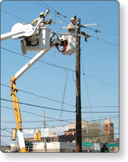
Private-Sector Responsibilities
Essential private-sector responsibilities include:
Planning for the protection of employees, infrastructure, and facilities.
Planning for the protection of information and the continuity of business operations.
Planning for responding to and recovering from incidents that impact their own infrastructure and facilities.
Collaborating with emergency management personnel before an incident occurs to ascertain what assistance may be necessary and how they can help.
Developing and exercising emergency plans before an incident occurs.
Where appropriate, establishing mutual aid agreements and assistance agreements to provide specific response capabilities.
Providing assistance (including volunteers) to support local emergency management and public awareness during response and throughout the recovery process.

Slide 21
Discussion Question
What can your agency or jurisdiction do to reduce costs associated with using private-sector sources?

Slide 22
Donations
During incidents, private-sector sources frequently wish to contribute goods and services free or at a reduced cost.
However, it is also important to have a procedure in place that clearly defines and documents the conditions under which goods and services are being offered. It is not unusual for jurisdictions to be billed at a later date for resources that were offered "free" in the initial response to the emergency. Making certain that the circumstances are clear helps ensure that donors are recognized for being good neighbors, and that there are no misunderstandings later.
Unsolicited donations are a specific concern that we cover briefly next. We will also discuss unsolicited donations later in this course.

Slide 23
Lessons Learned: Unsolicited Donations
No single jurisdiction has all required resources to respond to a catastrophic disaster. Mutual aid resources are a primary asset during a major emergency, and most jurisdictions have formal mutual aid agreements that support their needs. If not planned and coordinated, private-sector and donor assistance may not be effectively incorporated into the system, and could become a liability rather than an asset.
The City of Santa Cruz, CA has experienced the hazards of not planning for unsolicited donations. One time, a boat loaded with supplies donated to Santa Cruz arrived along the coast, but Santa Cruz has no port facilities to offload. On another occasion, Santa Cruz received a tractor trailer loaded with tennis shoes... but only for the left foot!

Slide 24
Activity: Identifying Potential Sources
Instructions: Working with your table group complete the activity. Use your student manual to complete the worksheets.
You will have 20 minutes to complete this activity.

Slide 25
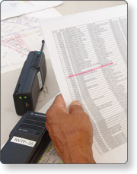
Step 4: Review Resource Management Procedures
Resource management procedures and protocols should detail the specific actions to implement a plan or system. Emergency management/response organizations should develop procedures and protocols that translate into specific, action-oriented checklists for use during incident response operations.
You may want to make sure that your procedures address the following resource management questions:
How do you get that resource in the middle of the night on a weekend when the owner/supervisor is out of town?
Do you have access to the necessary phone numbers and addresses?
Will you have to pay for this resource? If so, what is the rate? Are there additional costs associated with emergency use or after-hours activation?
Is purchasing authority delegated to the appropriate personnel in sufficient amounts to meet emergency needs?
What emergency declarations or legal frameworks must be activated or invoked?
How will the resource gain access to the incident scene?

Slide 26
Systems and Protocols
Effective resource management includes:
Systems: Management information systems collect, update, and process resource data and track the status and location of resources. It is critical to have redundant information systems or backup systems to manage resources in the event that the primary system is disrupted or unavailable.
Protocols: Preparedness organizations develop standard protocols to request resources, prioritize requests, activate and mobilize resources to incidents, and return resources to normal status.

Slide 27
Acquisition Strategies
Effective resource management includes establishing resource acquisition procedures. It is important to consider the tradeoffs (e.g., shelf life, warehousing costs) and determine the optimal acquisition strategies, including:
Acquiring critical resources in advance and storing them in a warehouse (i.e., “stockpiling”).
Supplying resources “just in time,” typically using a pre-established contract.
Planning for acquisition, storage and inventorying of resources should accommodate both resource acquisition strategies.

Slide 28
Shelf-Life or Special Maintenance Considerations
An important part of the process is managing inventories with shelf-life or special maintenance considerations. Strict reliance on stockpiling raises issues concerning shelf life and durability; however, strict reliance on “just in time” resources raises its own concerns related to timely delivery.
Assets that are counted on for "just in time" need to be accurately accounted for to ensure that multiple jurisdictions or private-sector organizations are not relying solely on the same response asset, which can lead to shortages during a response. Those with resource management responsibilities should build sufficient funding into their budgets for periodic replenishment, preventive maintenance, and capital improvements. An integral part of acquisition procedures is developing methods and protocols for the handling and distribution of donated resources.

Slide 29
Purchase Authority
Most jurisdictions limit purchasing authority to specific people and specific limits. While administrative rules addressing financial issues may work fine in the 40-hour/daylight-only workweek, it may not serve the organization well in an off-hour emergency. Stories abound of responders forced to purchase supplies with personal credit cards because official fiscal support was not available.
Each organization must:
Determine who, at what level in the organization, has what amount of purchasing authority.
Ensure that appropriate financial controls are observed at all levels.
Ensure that appropriate training and refresher training on jurisdiction purchasing and documentation procedures is completed.

Slide 30
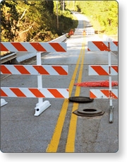
Controlling Access to the Scene
Planning efforts must consider procedures to manage the issues related to incident scene access. Convergence and self-dispatching represent a significant threat to scene safety and resource management. Your plans should include:
A method for identifying authorized personnel from other jurisdictions, volunteer organizations, or commercial vendors.
Procedures for clearing the incident scene of spectators, unauthorized volunteers, and survivors.
Methods for securing the cleared scene and limiting access points.
Personnel qualifications, certification, and credentialing will be discussed in the Resource Typing lesson.

Slide 31
Perform a Legal Review of Procedures
You may want to have your legal counsel review your organization's legal foundations for resource management as well as your resource management plan and/or annex to the Emergency Operations Plan. For example:
Goods and services frequently make a major leap in price following an incident. Many jurisdictions have put in place ordinances to prevent price gouging.
Contracting procedures, such as the amount of time contracts must be advertised, may need to be suspended following an incident.
Emergency purchasing authority may need to be delegated to Incident Commanders, department heads, Logistics Section Chiefs, or emergency managers.

Slide 32
Additional Legal Considerations
Additional legal questions to consider include:
Does the jurisdiction have authority under specific circumstances (such as lifesaving) to make use of personal property?
Are liability measures in place to protect both your jurisdiction and volunteers and their organizations?
Does your organization have an incident contingency fund? Who can access it, and under what conditions?
Do you have sufficient intergovernmental agreements in place to provide and receive mutual aid?

Slide 33
Activity 5: Acquire, Store, and Inventory Resources
After you have determined what you need, where you can find it, and how to procure it, the information needs to be organized, made accessible to those who need it, and maintained. Most organizations develop their own versions of "the yellow pages," including the type of resource, its owner, location, and procurement procedures.
Accessibility is also an issue. The most detailed inventory in the world is useless if staff can't access it. Inventories should be available in different formats stored at different locations. If the primary inventory is electronic, it may be advisable to have paper copies available for key Logistics and Finance/Administration workers, dispatchers, and Emergency Operations Center (EOC) staff.

Slide 34
Keeping Information Up to Date
Maintaining such resource inventories is time-consuming work. It takes time and attention to detail to make sure all information is up to date, but there are few things more frustrating than discovering you do not have an after-hours contact for hardware stores when you need plywood at 3:00 in the morning.
Most organizations update on an annual or semiannual basis. There is software available that will e-mail your contacts and ask for updates automatically.

Slide 35
Inventory Systems
Inventory systems for resource management should be adaptable and scalable and should account for the potential of double-counting personnel and/or equipment. In particular, resource summaries should clearly reflect any overlap of personnel across different resource pools. Personnel inventories should reflect single resources with multiple skills, taking care not to overstate the total resources.
For example, many firefighters also have credentials as emergency medical technicians (EMTs). A resource summary, then, could count a firefighter as a firefighter or as an EMT, but not as both. The total should reflect the number of available personnel, not simply the sum of the firefighter and EMT counts.
FEMA provides a "no cost" resource inventory tool. The Incident Resource Inventory System (IRIS) features the capability for users to inventory resources and share resource information with other agencies. Furthermore, users are able to define non-typed resources and select specific resources for mutual aid purposes based upon mission requirements, the capability and availability of resources, and desired response times. https://preptoolkit.fema.gov/web/nims-tools/home

Slide 36
Planning for Interorganizational Issues (1 of 2)
It is critically important to think through the relationships between and among the various command and coordination entities that are likely to be activated during an incident. Included in this analysis should be:
ICS organization on incident.
Dispatch organizations.
Mutual aid cooperators.
Unified Command.
Area Command.
Emergency service districts or other special mission governmental entities.
Local, county, regional, and State EOCs.
MAC Groups, VOAD Councils, State Emergency Boards, etc.
FEMA Regional Response Coordination Centers (RRCCs).
Joint Field Offices (JFOs).
Joint Information Centers (JICs).
A solution that works in one jurisdiction might be inappropriate (or illegal) in another.

Slide 37
Planning for Interorganizational Issues (2 of 2)
Dispatch centers or offices and agency ordering points manage resources on a day-to-day basis. Therefore, it is important to establish procedures that allow those who are unfamiliar with resource management procedures to integrate smoothly into these administrative structures during the stress and uncertainty inherent in an incident.
It is important that planners consider carefully the relationships among these structures as they relate to resource management.

